Slide 1
Visual Pattern Recognition
Evidence and Consequences of Feature Detection in The Visual Pattern Recognition of Reading by Taylor J. Meek is licensed under a Creative Commons Attribution-Noncommercial-Share Alike 3.0 United States License. These original publications may be accessed electronically from: http://www.lingnik.com/visual-pattern-recognition
Taylor J. Meek
October 22, 2009
Physiology
Features
Patterns

Slide 2
Physiological Visual System
Difference Detectors and Visual Aftereffects
Finding the Feature Detectors
Building Feature Detector Systems
Physiology
Features
Patterns

Slide 3
Difference Detectors
+
Input A
Base Level
+
-
No Activity
A
Difference
Detector
Basal Activity
+
B
Input B
Base Level
-
-
No Activity
No Activity
Physiology
Features
Patterns

Slide 4
Difference Detectors
Red
Red
Base Level
+
Tired
No Activity
Red
Difference
Detector
Neutral Color (Yellow)
Green
Green
Green
Base Level
Tired
-
No Activity
No Activity
Physiology
Features
Patterns

Slide 5
Difference Detectors
Red
Red
Base Level
+
Tired
No Activity
Red
Difference
Detector
Neutral Color (Yellow)
Green
Green
Green
Base Level
Tired
-
No Activity
No Activity
Physiology
Features
Patterns

Slide 6
Difference Detectors
+
Movement Up
Base Level
+
-
No Activity
Up
Difference
Detector
Basal Activity
+
Down
Movement Down
Base Level
-
-
No Activity
No Activity
Physiology
Features
Patterns

Slide 7
Aftereffects
Complementary Color Photoreceptors
Something More Abstract
“The McCollough Effect”

Slide 9
Notes:
45s

Slide 10
Notes:
15s

Slide 13
1
(Gibson & Harris 1968 in Lindsay & Norman 1977)
Notes:
8m

Slide 14
2
(Gibson & Harris 1968 in Lindsay & Norman 1977)

Slide 15
(Gibson & Harris 1968 in Lindsay & Norman 1977)

Slide 19
Difference Detectors
So what?
Eye Transfer
Color Desensitization
Motion Detector Desensitization
Orientation-specific Line Detectors
Physiology
Features
Patterns

Slide 20
Feature Detectors
++-
++-
++-
--+
--+
--+
Edge
Slit/Line
Dimness
+-+
+-+
+-+
-+-
-+-
-+-
+++
+++
+++
---
---
---
Physiology
Features
Patterns
Notes:
The photoreceptors feed into feature detectors which locate specific and unique features.

Slide 21
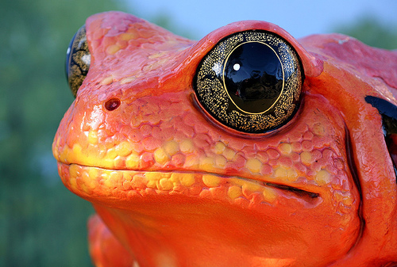
Physiological Feature Detectors
Edge
Convex
Edge
Moving
Contrast
(Edge)
Dimness
Physiology
Features
Patterns
http://flickr.com/photos/thomashawk/90125879/
Toad by Thomas Hawk, under CC License

Slide 22
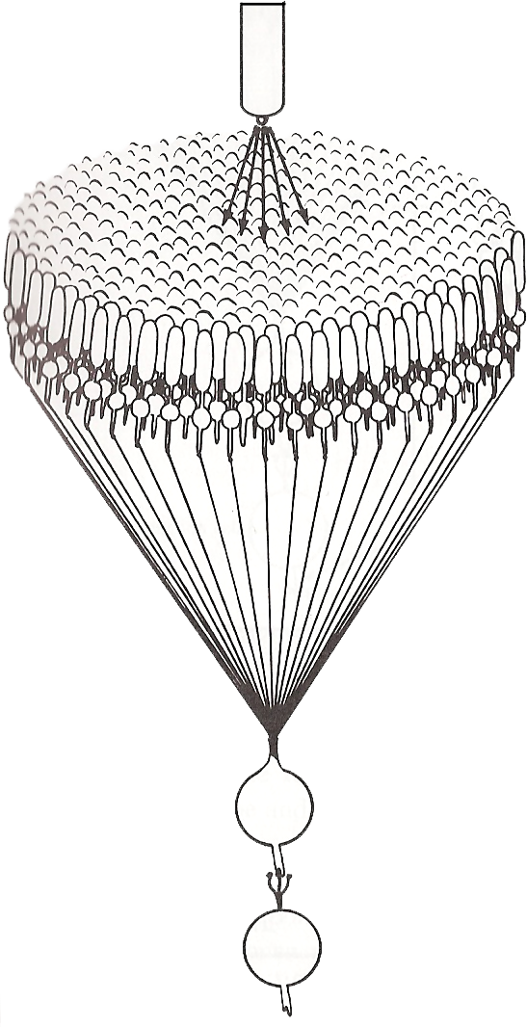
Feature Detectors in Higher-Order Species
Light
Ganglion & Bi-Polar Cells
On-Center, Off-Surround
Off-Center, On-Surround
Light Onset, Extinction
Peculiar Receptive Fields
Color Specificity, Contrast
Movement (Directional)
Receptive
Field
Ganglion Cell
(Lindsay & Norman 1977, p.215)
Physiology
Features
Patterns

Slide 23
Simple Feature Detector Cells in Higher-Order Species
+-+
+-+
+-+
-+-
-+-
-+-
Slit and Line
Edge
Selective to:
Location
Type
Orientation/direction
Width
++-
++-
++-
--+
--+
--+
Physiology
Features
Patterns

Slide 24
Complex Feature Detector Cells in Higher-Order Species
+-+
+-+
+-+
-+-
-+-
-+-
Slit and Line
Edge
Selective to:
Location
Type
Orientation/direction
Width
++-
++-
++-
--+
--+
--+
Physiology
Features
Patterns

Slide 25
Hyper-Complex Feature Detector Cells in Higher-Order Species
Size/Endpoint Termination
Movement (Axial Bidirectional)
Angle
Physiology
Features
Patterns

Slide 26
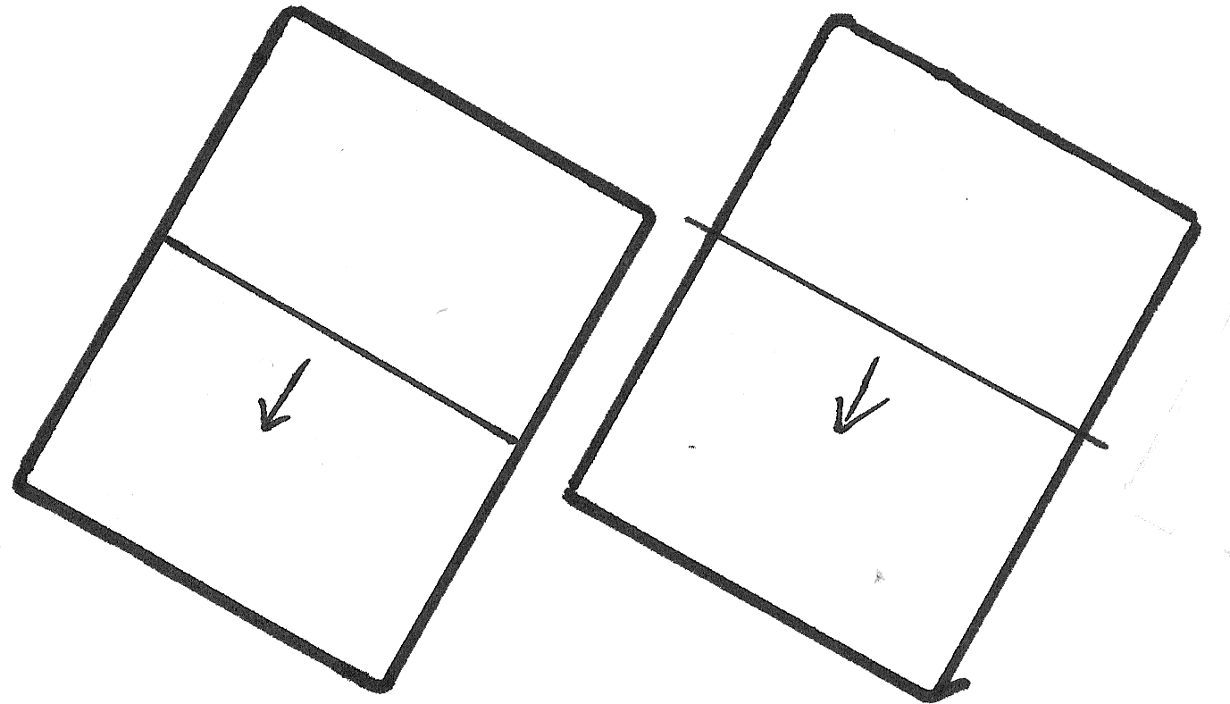
Hyper-Complex Feature Detector Cells in Higher-Order Species
Size/Endpoint Termination
Physiology
Features
Patterns

Slide 27
Hyper-Complex Feature Detector Cells in Higher-Order Species
Size/Endpoint Termination
Physiology
Features
Patterns

Slide 28
Hyper-Complex Feature Detector Cells in Higher-Order Species
Movement (Bidirectional)
Physiology
Features
Patterns

Slide 29
Hyper-Complex Feature Detector Cells in Higher-Order Species
Angle
Physiology
Features
Patterns

Slide 30
Higher-Level Feature Detector Cells in Higher-Order Species
Physiology
Features
Patterns

Slide 31
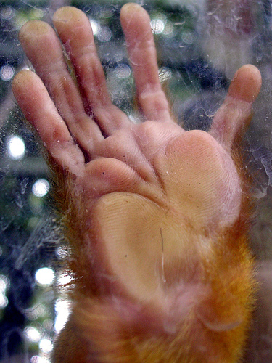
Higher-Level Feature Detector Cells in Higher-Order Species
http://flickr.com/photos/crowolf/205180735/
The Monkey Paw by John “Jay” Glenn, under CC License
Physiology
Features
Patterns

Slide 32
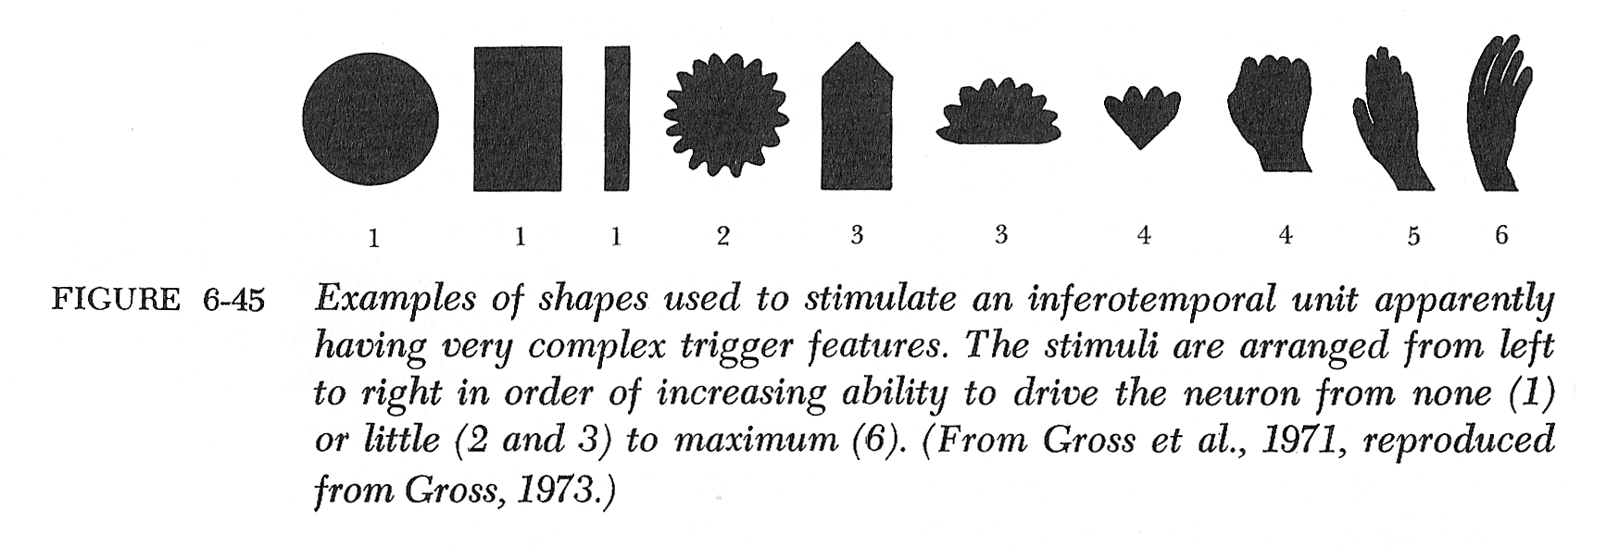
Higher-Level Feature Detector Cells in Higher-Order Species
Physiology
Features
Patterns
(Lindsay & Norman 1977, p.250)

Slide 33
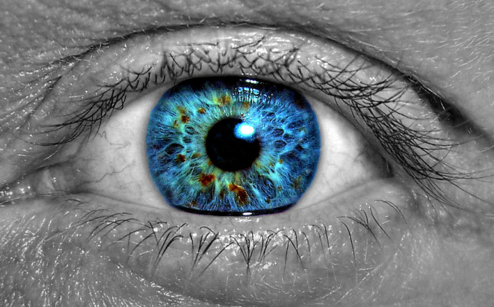
Building Up Complex Feature Detectors
Ganglion & Bipolar Cells
Simple Feature Detectors
Complex Feature Detectors
Hyper-Complex Feature Detectors
Higher-Level Feature Detectors
http://flickr.com/photos/residae/386508456/
Father of the Eye by Desirae, under CC license
Physiology
Features
Patterns

Slide 35
Cognitive Feature Detection
Features and Grouping
Geon Theory
Physiology
Features
Patterns

Slide 36
Features and Objects

Slide 37
Physiological Nystagmus Jiggly Eye Movements
http://en.wikipedia.org/wiki/Image:Optokinetic_nystagmus.gif
Available under GNU Free Documentation License,
http://commons.wikimedia.org/wiki/Commons:GNU_Free_Documentation_License
Physiology
Features
Patterns

Slide 39
(Verheijen 1961 in Lindsay & Norman 1977)

Slide 41
Physiological Nystagmus Jiggly Eye Movements
Physiology
Features
Patterns
(Dodwell 1970, p.188)

Slide 42
Physiological Nystagmus Jiggly Eye Movements
Physiology
Features
Patterns
(Lindsay & Norman 1977, p.40-44)

Slide 43
Segmental Image Loss
Physiology
Features
Patterns
(From R.M. Pritchard, Scientific American, 1961 in Lindsay & Norman 1977)

Slide 44
Object Segmentation into Features
Physiology
Features
Patterns

Slide 45
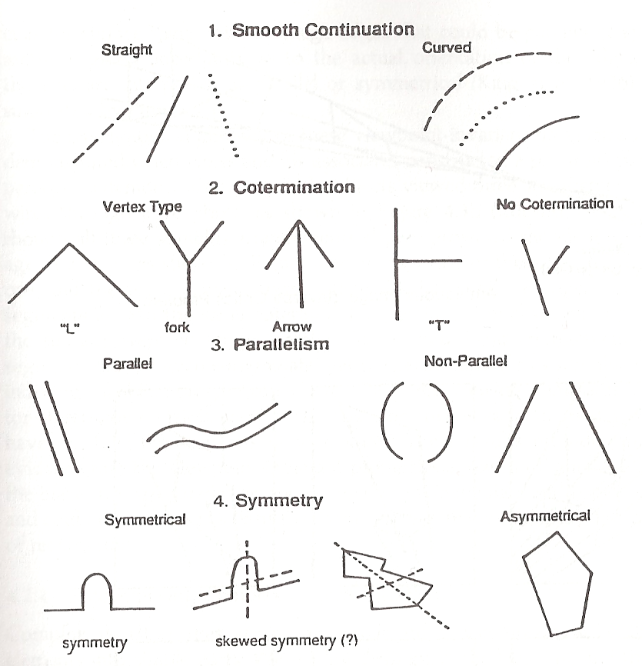
Feature Classes
Physiology
Features
Patterns
Biederman (1995)

Slide 46
Feature Relation
Physiology
Features
Patterns

Slide 47
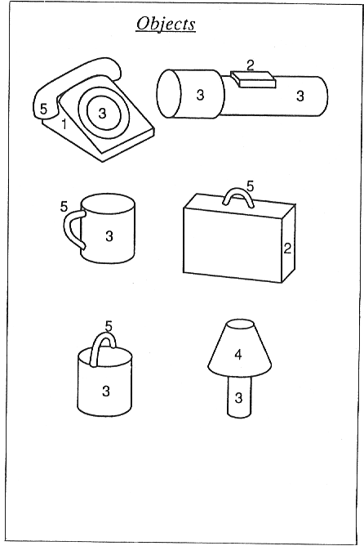
Geons
Physiology
Features
Patterns
Biederman (1995)

Slide 48
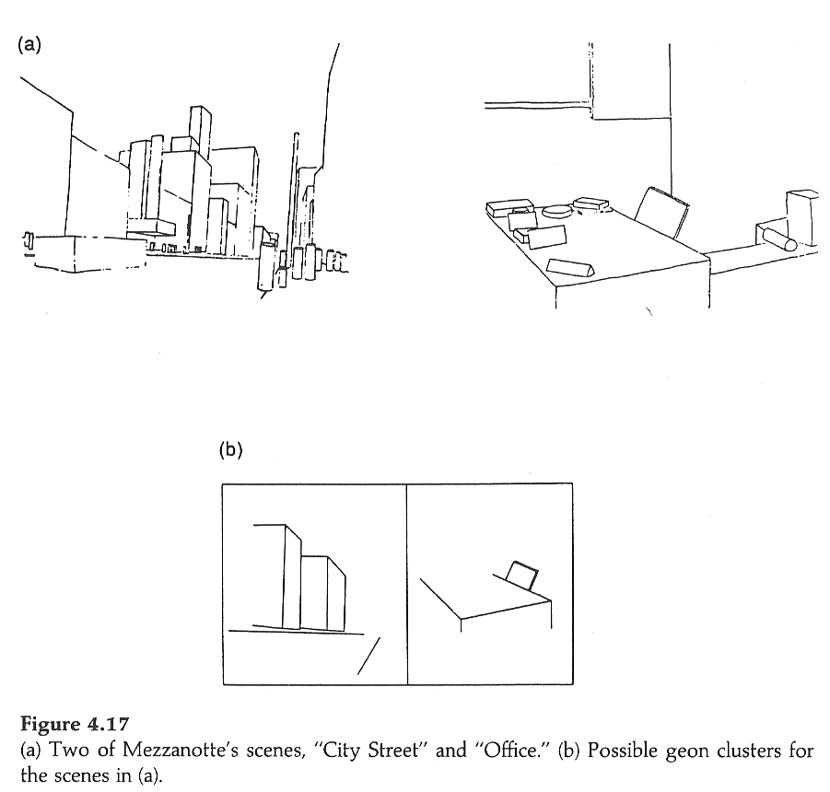
Geons to Scenes
Physiology
Features
Patterns
Biederman (1995)

Slide 49
Features
Sensory Input
Physiological Features
Simple→Complex→Hypercomplex→Higher-Level
Feature Classes + Feature Relations
Object Segments
Objects

Slide 50
Pattern Recognition
Pandemonium Revisited
Physiology
Features
Patterns

Slide 51
Evidence and Consequences of Feature Detection in The Visual Pattern Recognition of Reading by Taylor J. Meek is licensed under a Creative Commons Attribution-Noncommercial-Share Alike 3.0 United States License. These original publications may be accessed electronically from: http://www.lingnik.com/visual-pattern-recognition

